Slide 1
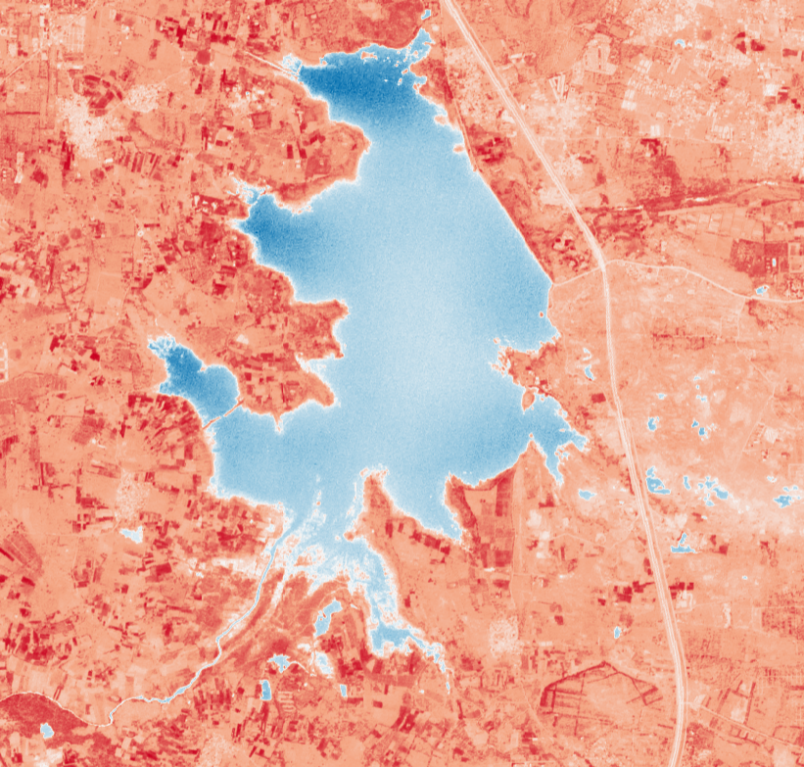
MULTI-TEMPORAL WATER BODY ANALYSIS OF HYDERABAD’S URBAN LAKES USING DEEP LEARNING
Submitted By -
K Ritanshu Kumar
22MID0328
Under the Guidance of -
DR. Rohini S
Department of Computer Science and Engineering
Vellore Institute of Technology, Vellore

Slide 2
2026
OUTLINE
  Area of the Project
  Background of the Problem
  Problem Statement
    Proposed Work
    Novelty
  Conclusion
  Thank You
Department of Computer Science and Engineering
Vellore Institute of Technology, Vellore

Slide 3
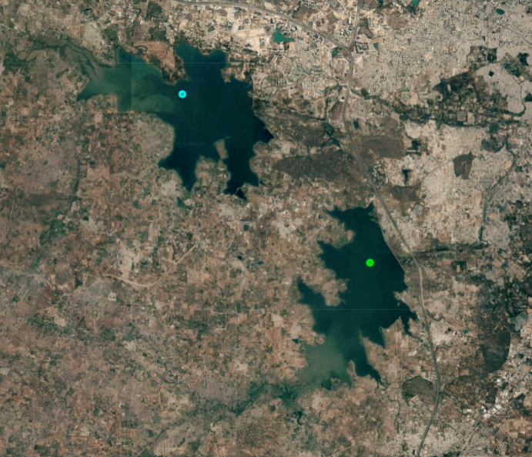
AREA OF THE PROJECT
  This project is an interdisciplinary application of Artificial Intelligence and Remote Sensing for environmental monitoring.
  It focuses on analyzing temporal changes in the surface area of Hyderabad's urban lakes using satellite imagery and deep learning techniques.
Study Lakes
  Hussain Sagar
  Osman Sagar
  Himayat Sagar
  Remote Sensing & Geospatial Analysis
  Artificial Intelligence & Deep Learning
  Computer Vision
  Environmental Monitoring
  Urban Water Resource Management
Satellite view of Hyderabad showing selected urban lakes.

Slide 4
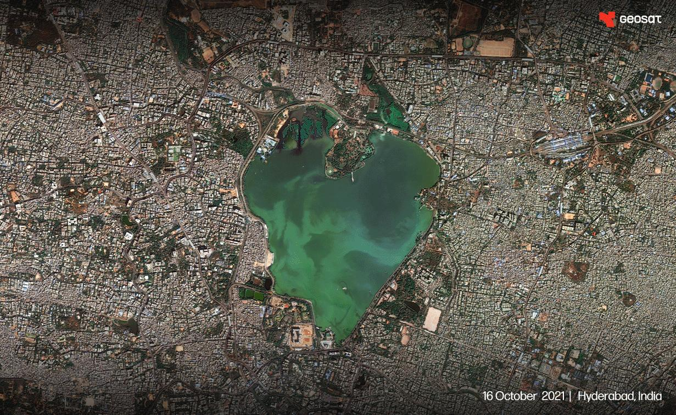
BACKGROUND OF THE PROBLEM
  Urban lakes support groundwater recharge, flood control, and biodiversity.
  Urbanization, pollution, and encroachment are degrading Hyderabad's lakes.
  Monitoring lake surface area is essential for environmental conservation.
  Traditional monitoring is manual and time-consuming.
  Satellite imagery + Deep Learning enables efficient long-term monitoring.
Aerial view of Hussain Sagar Lake, Hyderabad.

Slide 5
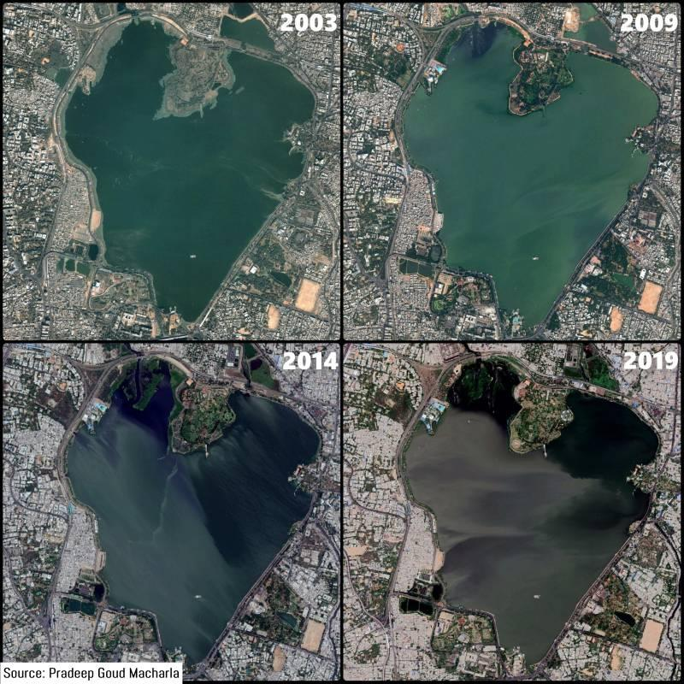
PROBLEM STATEMENT
  Hyderabad's urban lakes are undergoing changes due to urbanization, pollution, and encroachment.
  Existing monitoring methods are manual, time-consuming, and difficult to scale.
  There is a need for an automated and reliable approach to monitor lake surface area over time.
Figure: Multi-temporal satellite images illustrating changes in Hussain Sagar Lake.

Slide 6
PROPOSED WORK
NOVELTY
Collect Sentinel-2 satellite imagery (2018–2025).
Focuses on Hyderabad's three major urban lakes.
Preprocess satellite images for analysis.
Integrates Sentinel-2 imagery with U-Net-based segmentation.
Apply U-Net-based semantic segmentation to identify water bodies.
Enables automated monitoring of water bodies.
Estimate year-wise lake surface area and analyze temporal changes.
Provides year-wise quantitative analysis of lake surface area changes.

Slide 7
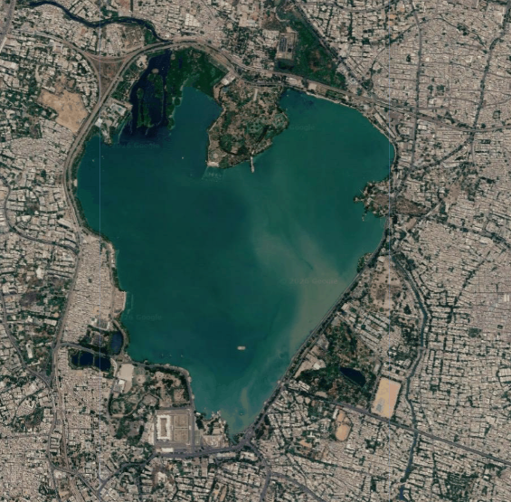
CONCLUSION
Presented the need for automated monitoring of Hyderabad's urban lakes.
Selected Sentinel-2 imagery and Hyderabad's three major lakes for the study.
Proposed a U-Net-based deep learning framework for water body segmentation.
Future work includes model development, surface area estimation, and temporal analysis.
Aerial view of Hussain Sagar Lake, Hyderabad.

Slide 8
THANK YOU
Department of Computer Science and Engineering
Vellore Institute of Technology, Vellore

